Slide 1
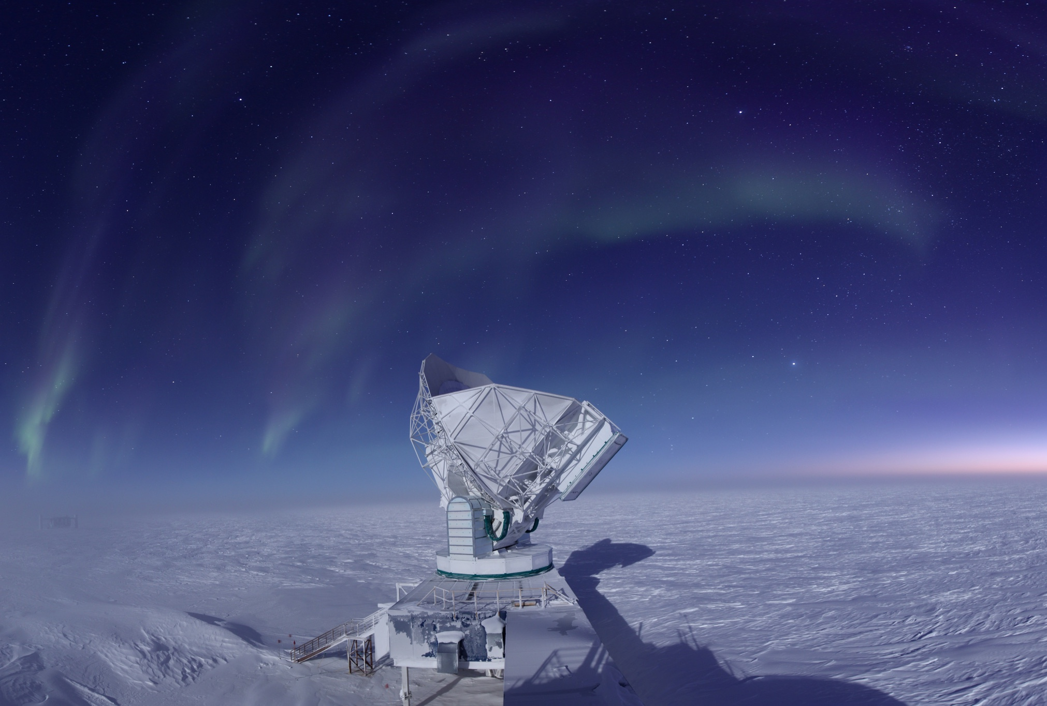
Astronomy 100/101 Lab 6
Jason Gallicchio
South Pole Telescope (SPT)
Amundsen-Scott South Pole Station
Antarctica
Wednesday 21 Apr/28 Apr 2021 11.15am
Yvonne Ban: yiwenban@astro.umass.edu
Patrick Kamieneski: pkamieneski@astro.umass.edu

Slide 2
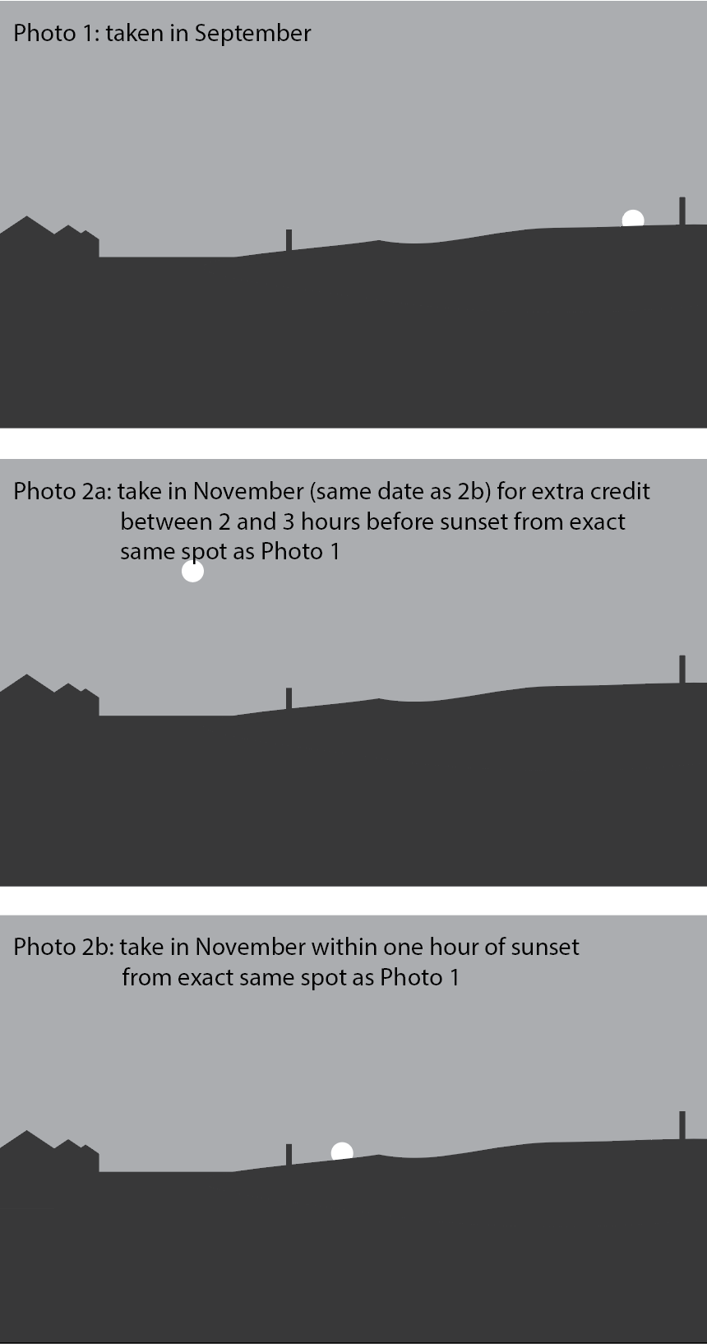
Headstart on Lab 6 and Extra Credit Opportunity
For the final lab, you will be measuring how the Sun’s position has shifted since Lab 1.
Take another picture of the sunset(/sunrise) from the same spot as you took your first picture.
Extra credit: Take two pictures, one 2-3 hours before sunset(/sunrise) and another within one hour of sunset(/sunrise).
Don’t wait! Weather is unpredictable!

Slide 3

Labs are 25% of the total course grade.

Slide 4
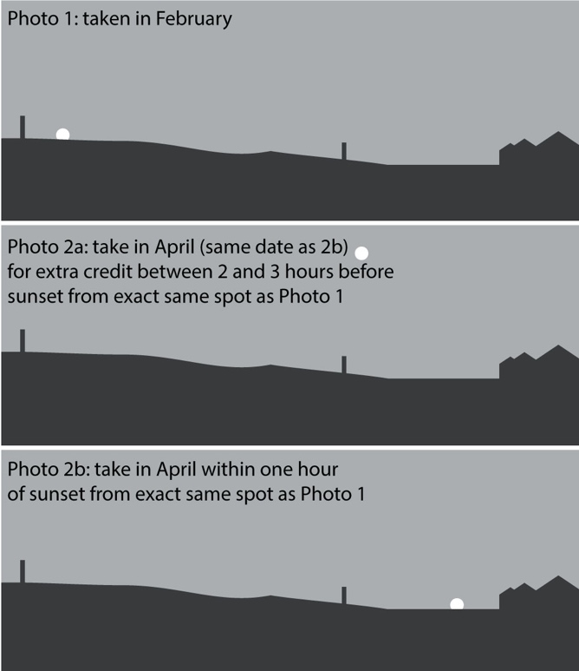
Tempus fugit…
Remember: in Lab 1, you took a picture of the sunset (/sunrise) (Photo 1).
Now, take another picture from the same place (Photo 2b) and compare the pictures to see how the Sun has moved.
Extra credit: take a picture of the Sun (Photo 2a):
2-3 hours BEFORE sunset if your Lab 1 picture was a sunset
2-3 hours AFTER sunrise if your Lab 1 picture was a sunrise

Slide 5
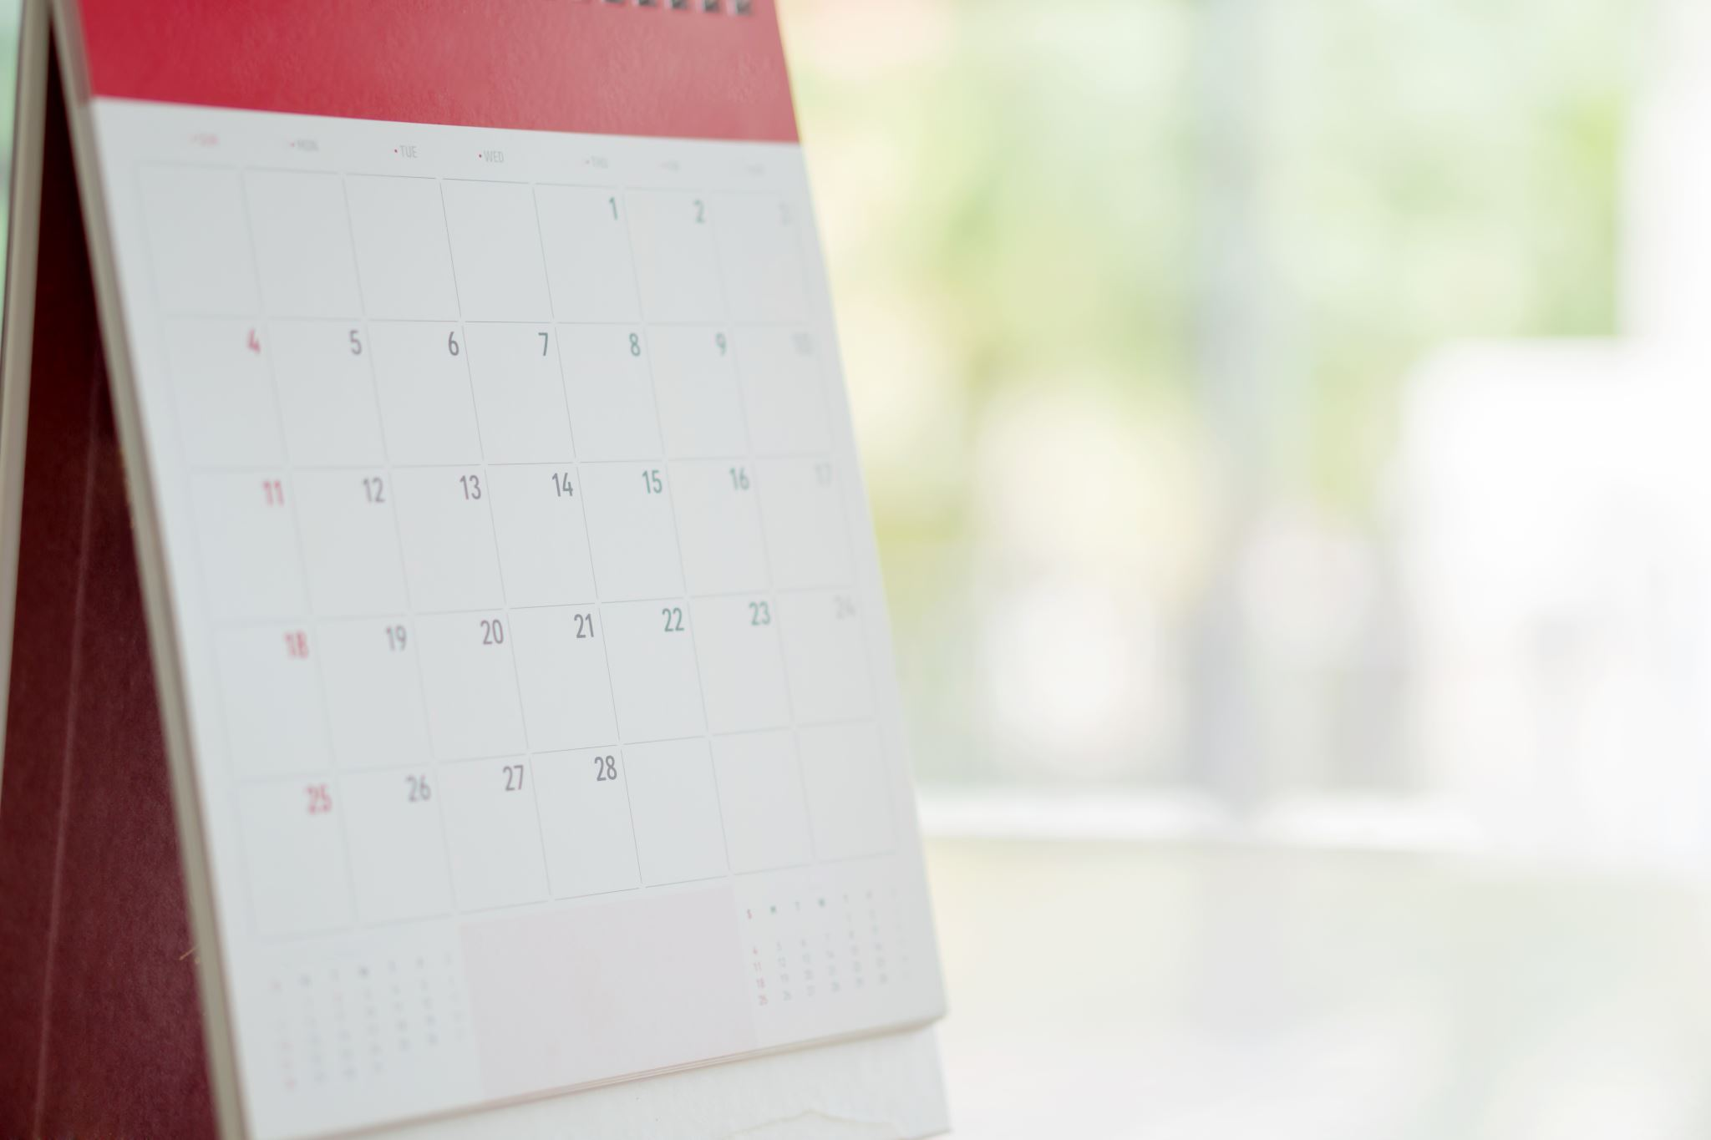
Tempus fugit…
Planning your picture:
Check the weather forecasts and pick at least two dates when it will be clear at sunset(/sunrise).
In Stellarium, set it to your picture location on these dates and find the time of sunset(/ sunrise).
Depending on objects on your horizon, the sunset may be earlier than indicated, and the sunrise might be later.
Return to your picture location using your location picture from Lab 1. Take a picture of the sunset(/sunrise).
Do the foreground features in your pictures line up? If not, why not?

Slide 6

Wake me up when semester ends
Like in Lab 1, find the altitude and azimuth of the Sun at sunset(/sunrise) on the day you take your second picture.
Compare with your data from Lab 1:
the azimuth
How much has the Sun shifted in azimuth? How many degrees has it shifted per day on average?
the time
How much has the sunset time shifted? (Make sure to account for the change from standard time to daylight saving time!)
In Stellarium, find the azimuth of the sunset (/sunrise) on the spring equinox (20 Mar).
How does this compare to the azimuth shift you found?

Slide 7
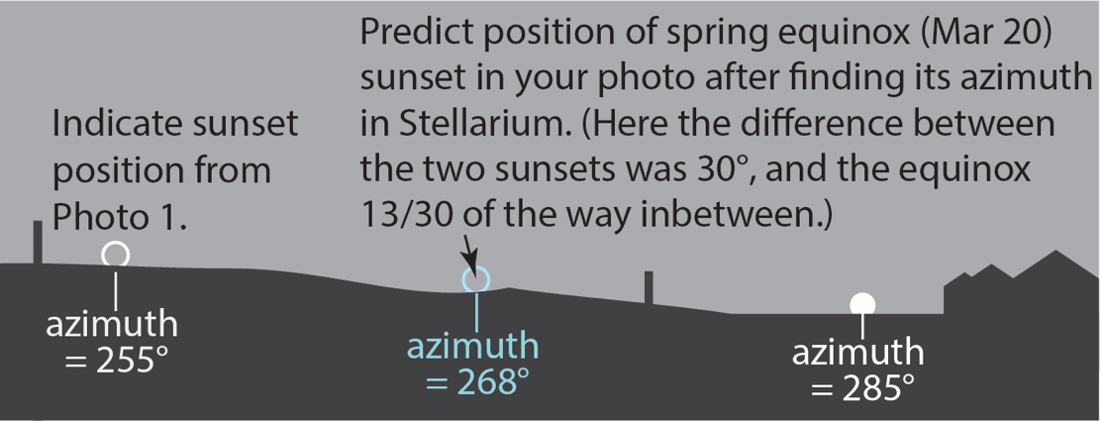
Wake me up when semester ends
Use the values you found to mark up your second sunset (/sunrise) picture:
Sunset(/sunrise) position from photo 1
Sunset(/sunrise) position on the spring equinox
If the positions don’t fit in your second picture, take another picture (any time) and indicate all three positions.

Slide 8
Wake me up when semester ends
Extra credit: Write up your answer in a document and submit separately.
Using your same-day photos, mark the position of the Sun 2-3 hours before sunset (/after sunrise) on your picture at sunset(/sunrise). Take Stellarium screenshots of the times of your two pictures.
Estimate the angle from vertical that the Sun is moving towards(/from) the horizon. Describe your method and compare this angle to your latitude.
Connection to part 3: You can use the azimuth of the Sun before sunset as an alternative way of estimating the position of the spring equinox sunset along the horizon.

Slide 9
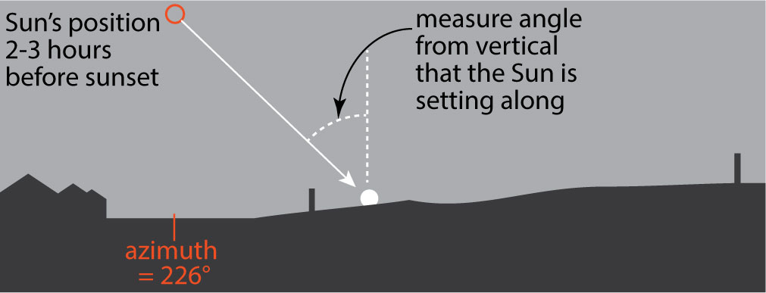
Wake me up when semester ends
Extra credit: Same-day photos

Slide 10

One survey more…
Please fill out the post-class survey on Moodle!
Same as the one you took in Lab 0 (week 1)
Again, graded only on participation

Slide 11
Due: Wed 5 May 2021 23:59
Take a picture of the sunset(/sunrise) from the same position as you did in Lab 1.
For extra credit: take a picture of the Sun 2-3 hours before sunset (/after sunrise).
Fill out the Lab 6 questions on Moodle. You will need to calculate azimuths and times.
Annotate (mark up) your second (later) sunset(/sunrise) picture with the positions of the first sunset(/sunrise) and the sunset(/sunrise) on the spring equinox (20 Mar).
Extra credit: Submit your write-up calculating the angle of the Sun setting(/rising).
Fill out the post-class survey on Moodle.
Enjoy!

Slide 12
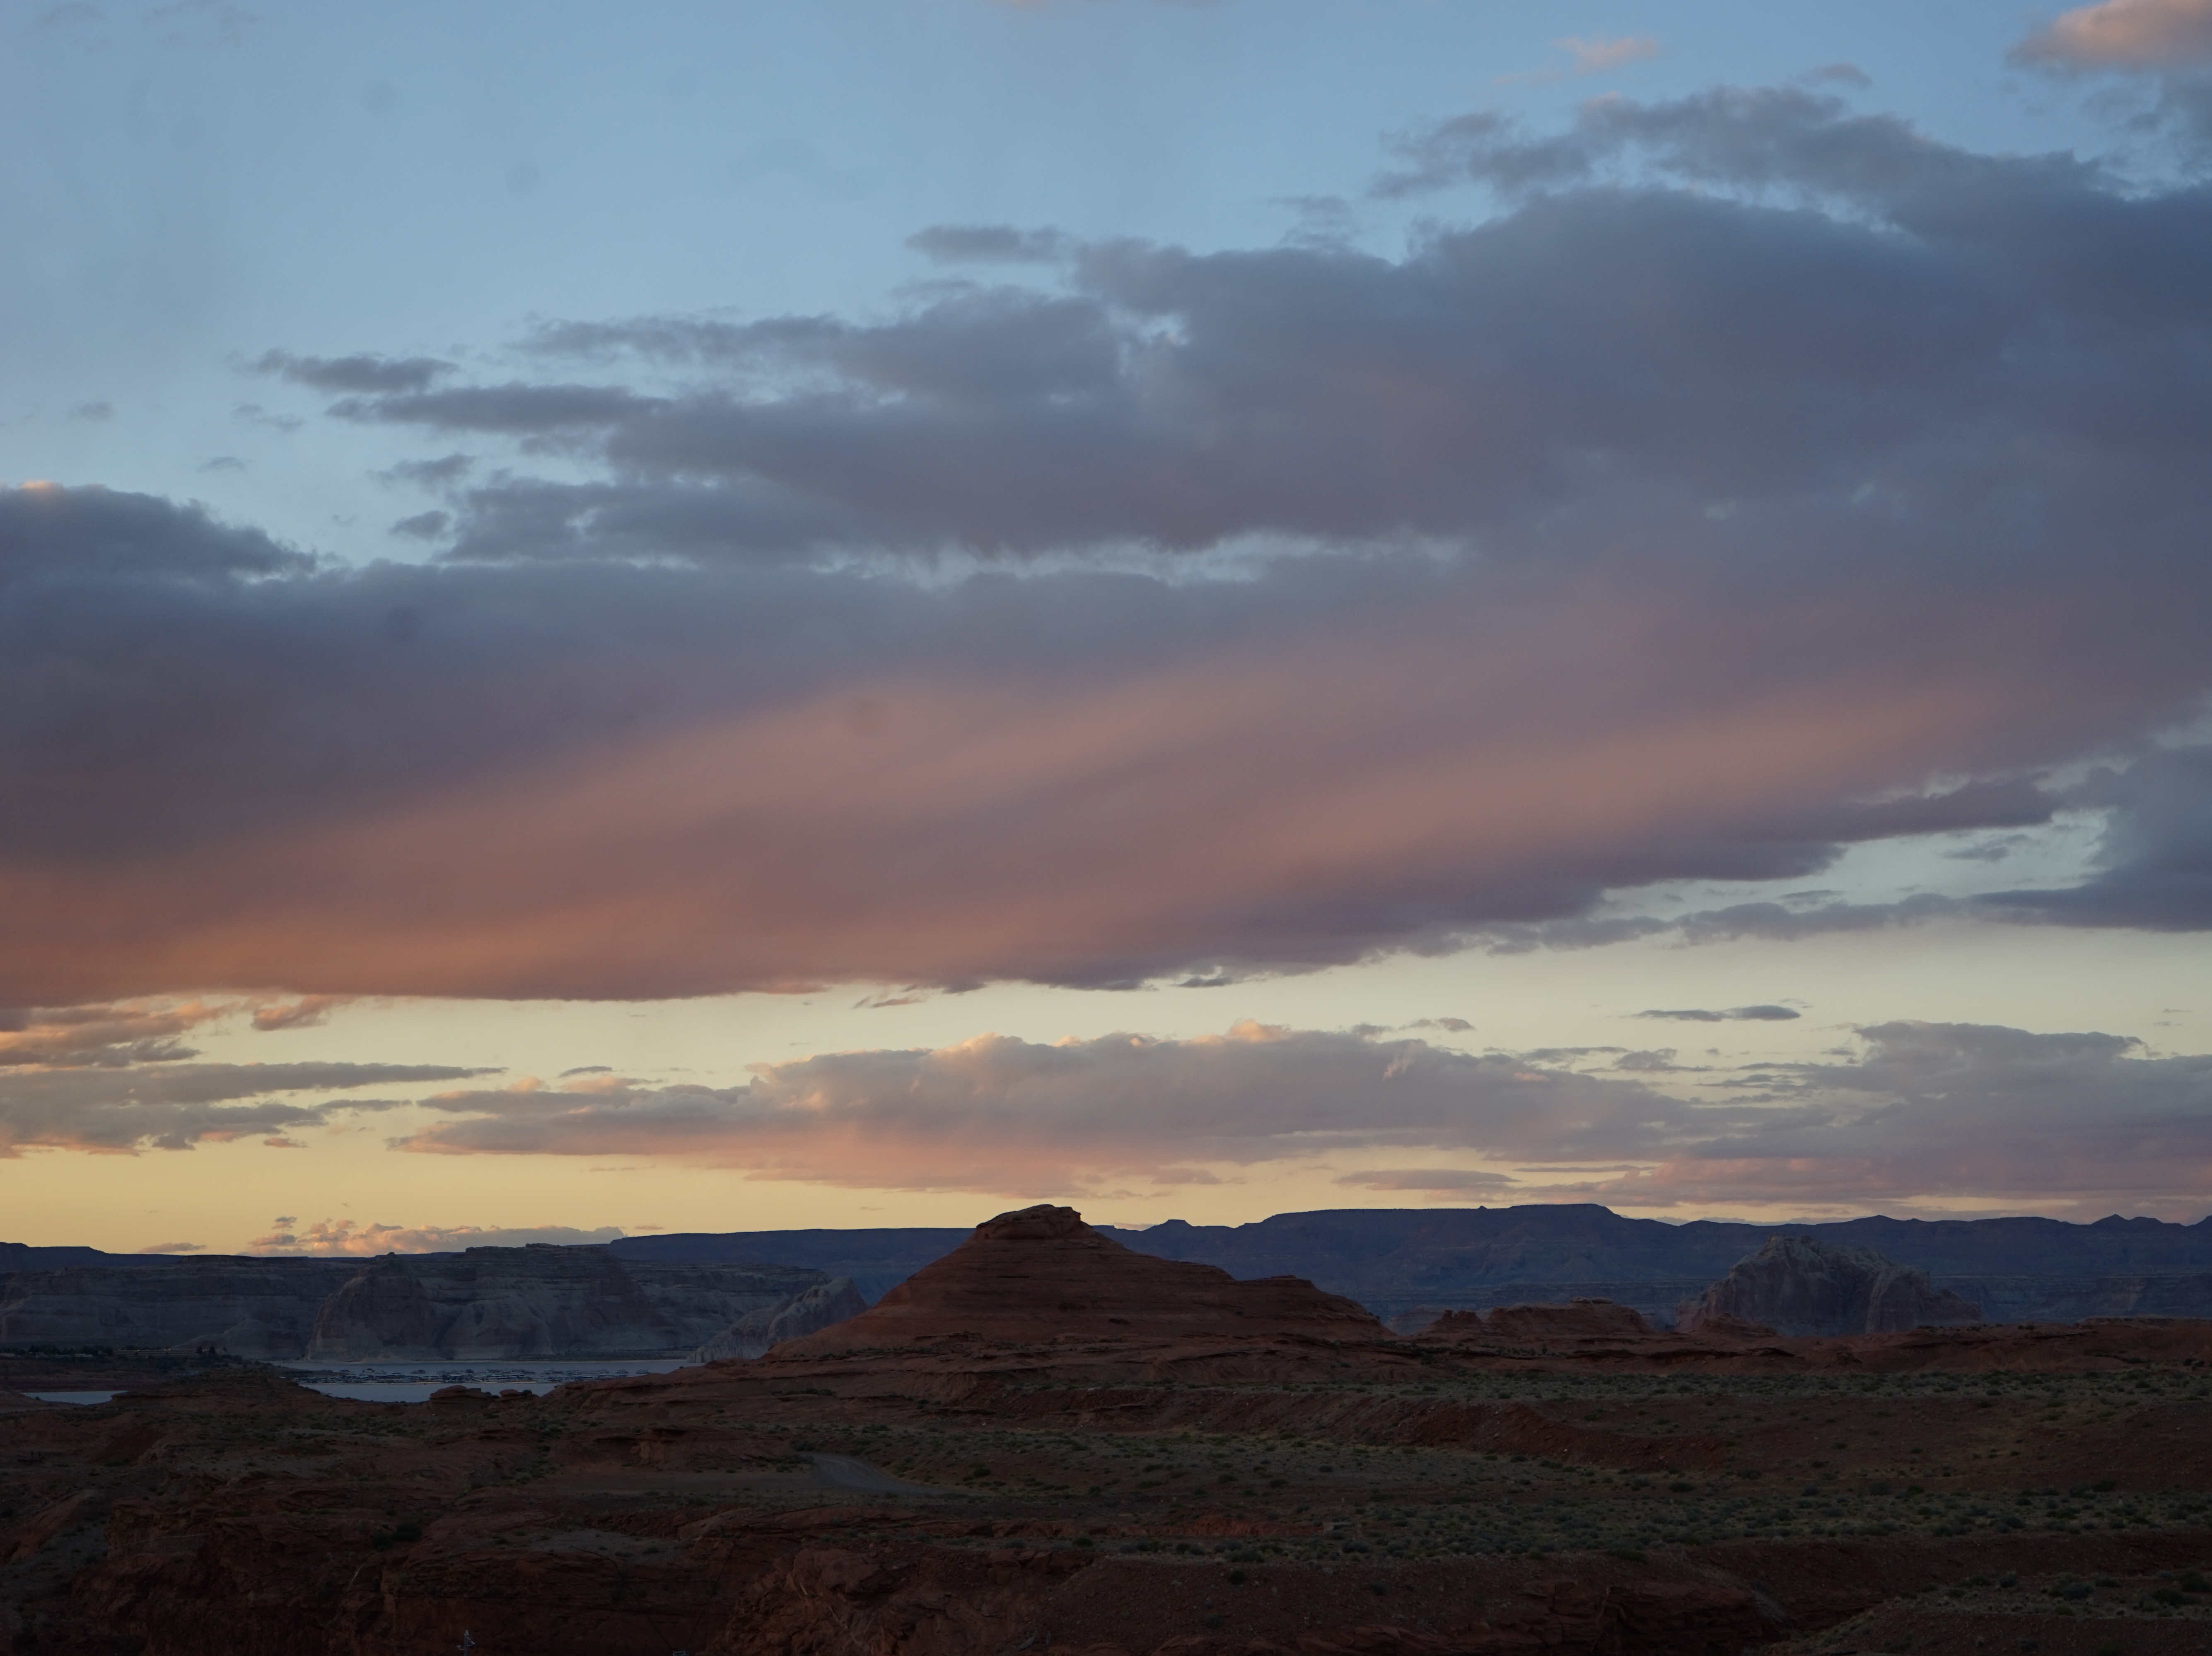
Keep looking up!
Yvonne Ban
20 May 2017

